Slide 1

Machine Learning
Teaching machines how to predict

Slide 2
What is Machine Learning ?
Machine learning is a field of computer science that uses statistical techniques to give computer systems the ability to "learn" with data, without being explicitly programmed.
Advantages
Disadvantages
Inferring knowledge from data
Usually no assumptions
Computational challenges are answered
Less feature engineering is required
Good accuracy
Over fitting is a huge drawback
Blackbox – Interpretation becomes hard at times
It is not a guarantee that machine learning algorithms will always work in every case imaginable
Large data requirements

Slide 3
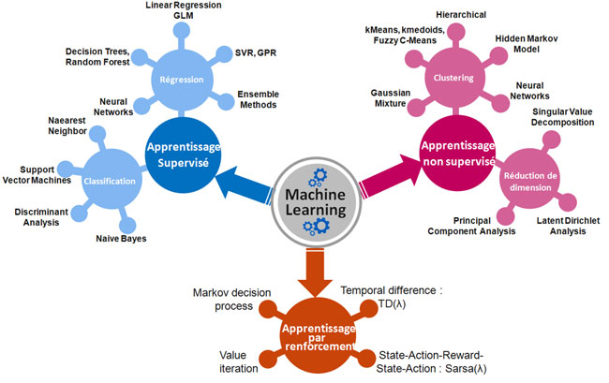
Regression
Clustering
Supervised
Learning
Unsupervised
Learning
Classification
Dimensionality Reduction
Reinforcement learning

Slide 4
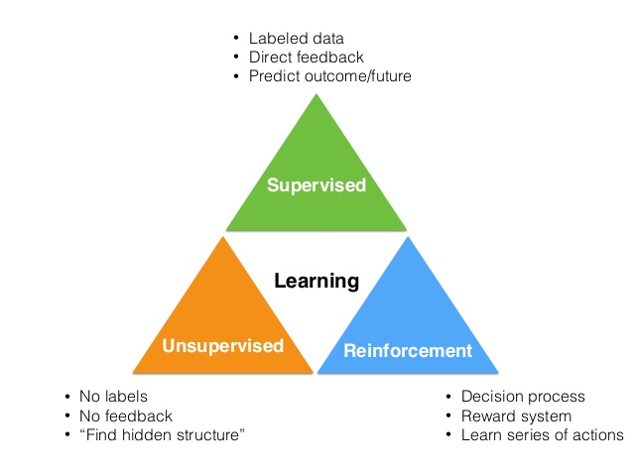
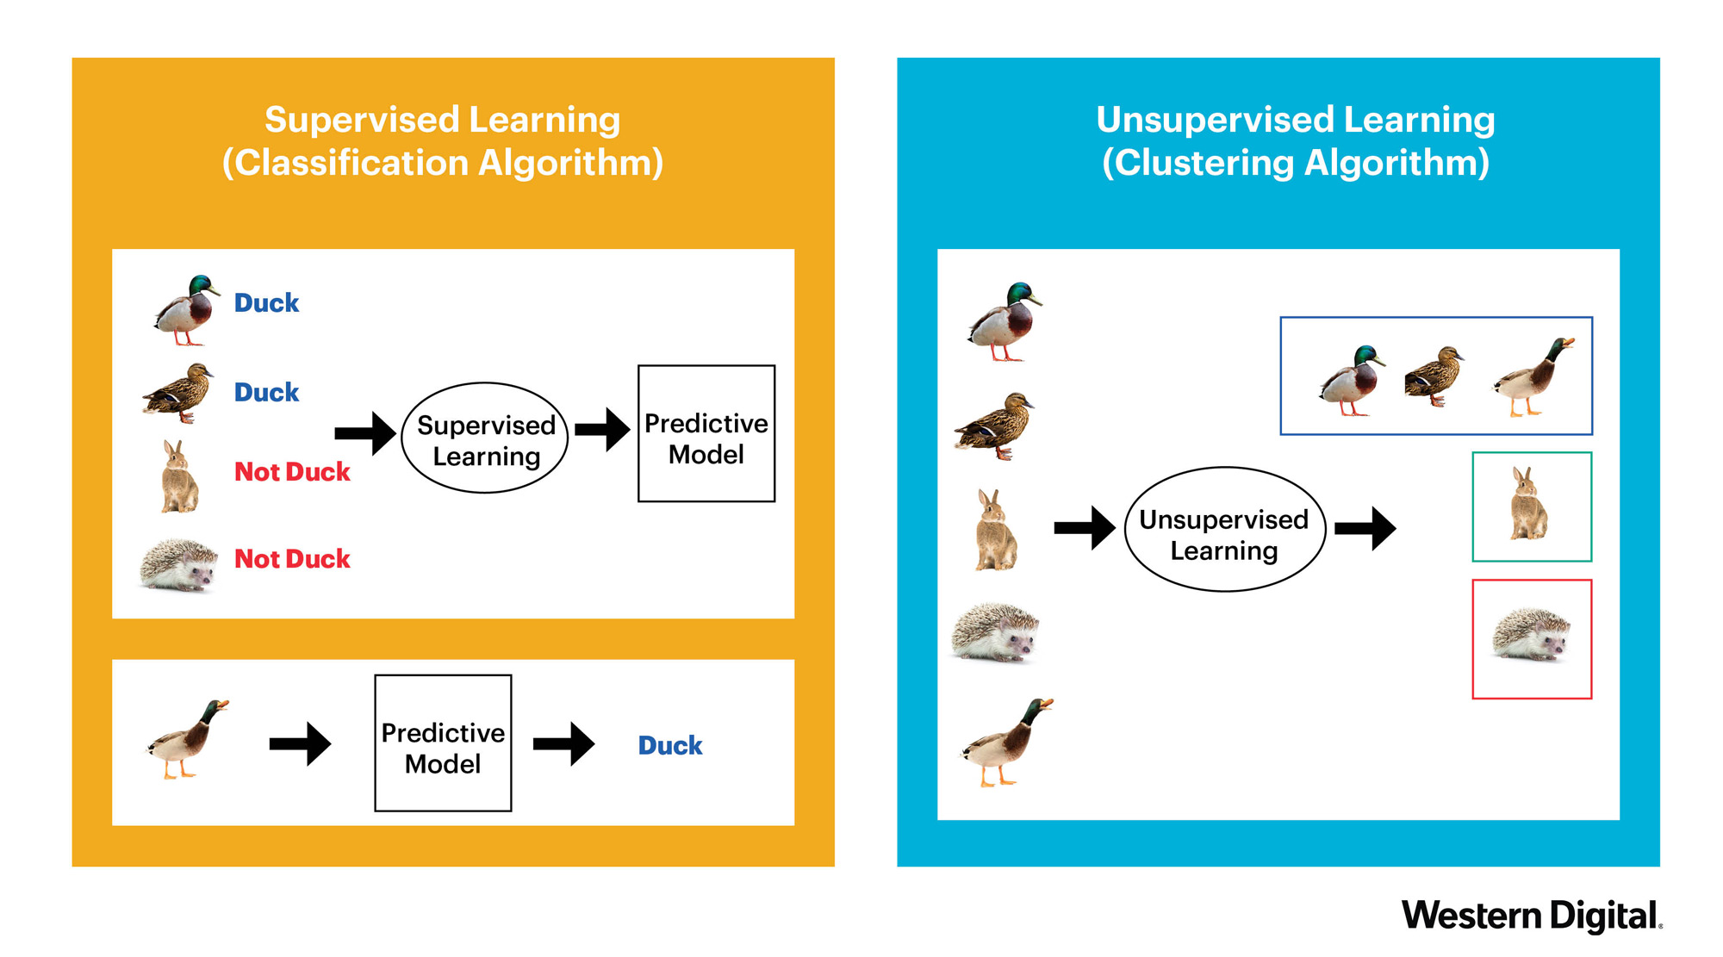
Supervised Learning vs Unsupervised Learning

Slide 5
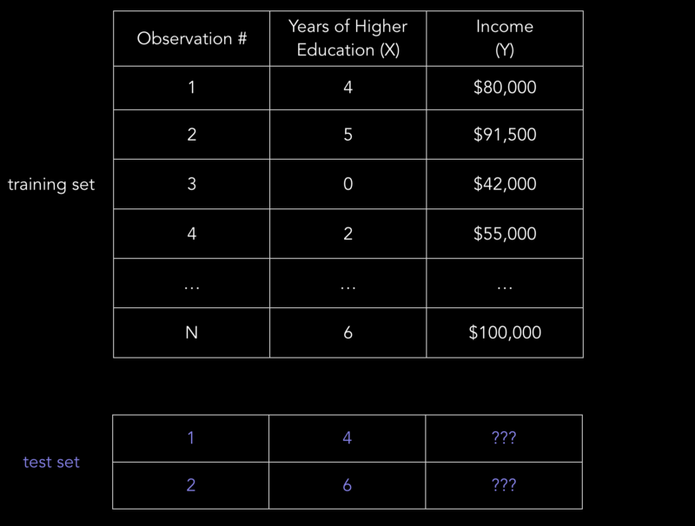
Supervised Learning Example

Slide 6
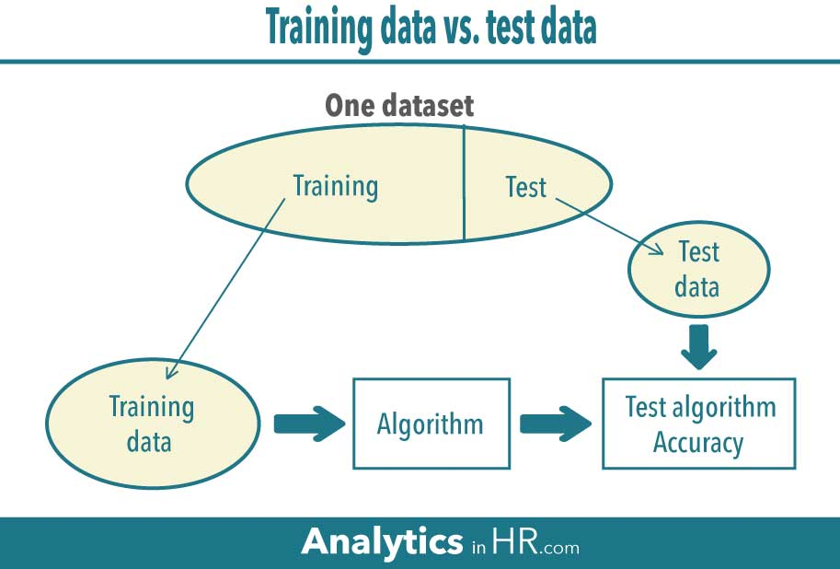

Slide 7
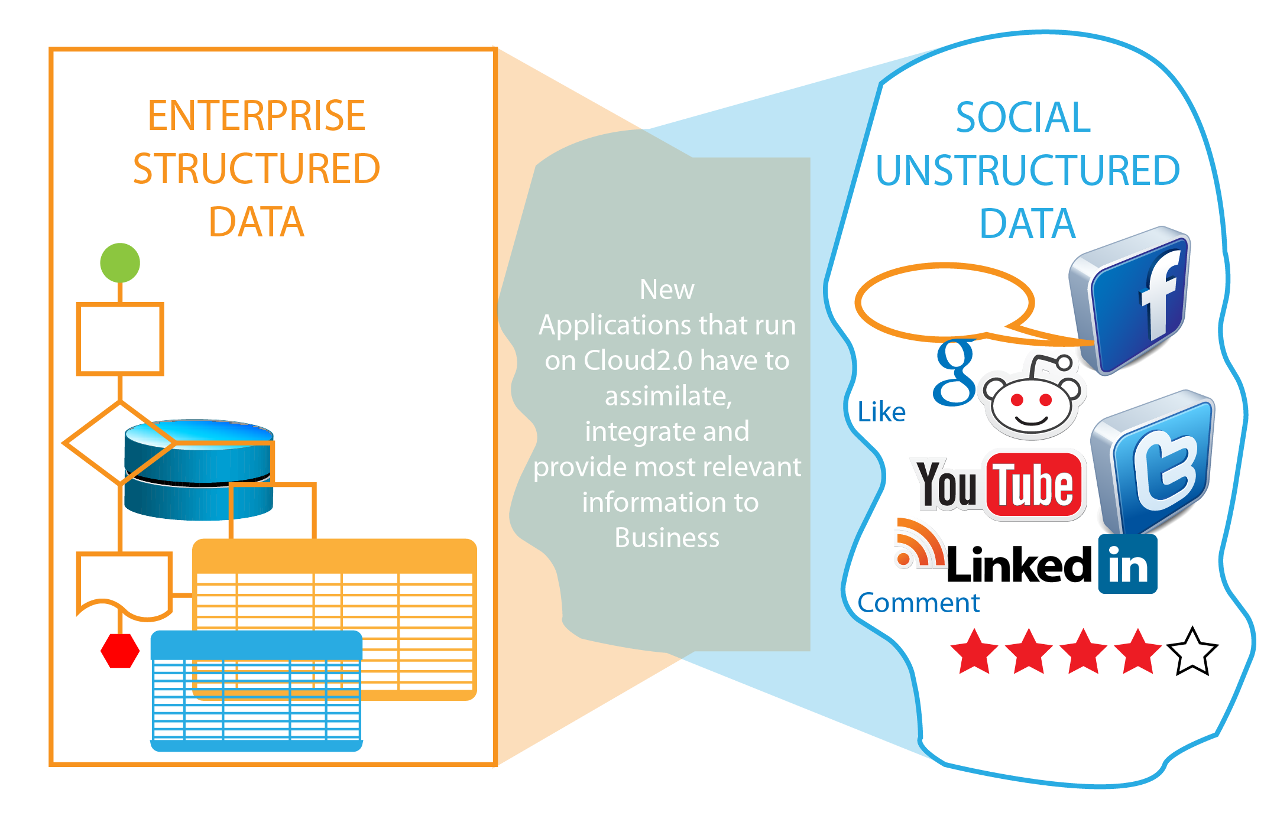
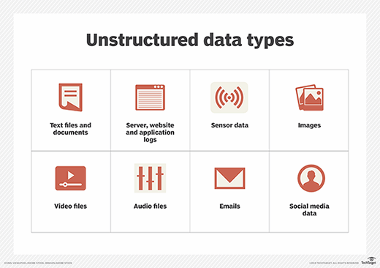
Data

Slide 8
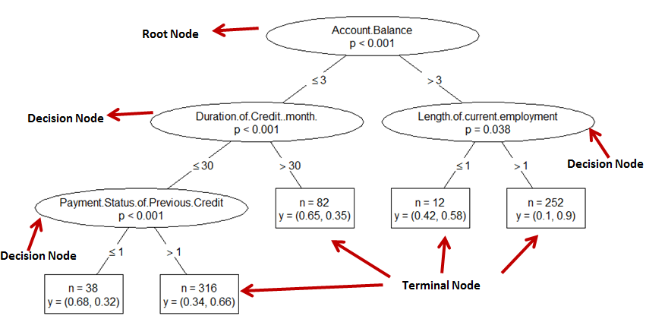
Tree based Algorithms – Decision Tree
Supervised | Regression | Classification

Slide 9
Decision Tree Algorithms
Reduction in Variance
Reduction in variance is an algorithm used for continuous target variables (regression problems). This algorithm uses the standard formula of variance to choose the best split. The split with lower variance is selected as the criteria to split the population
Chi-Square
It is an algorithm to find out the statistical significance between the differences between sub-nodes and parent node. We measure it by sum of squares of standardized differences between observed and expected frequencies of target variable.
It generates tree called CHAID (Chi-square Automatic Interaction Detector)
Gini Index
Gini index says, if we select two items from a population at random then they must be of same class and probability for this is 1 if population is pure.
CART (Classification and Regression Tree) uses Gini method to create binary splits.

Slide 10

Tree based Algorithms – Random Forest
Supervised | Regression | Classification

Slide 11
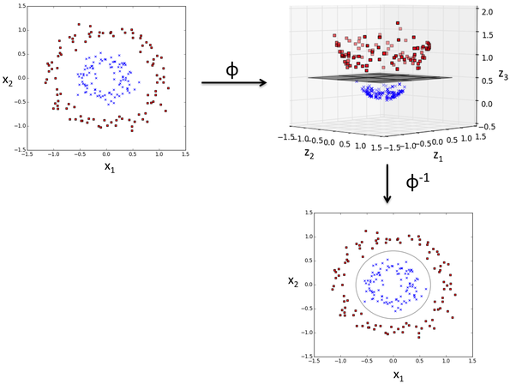
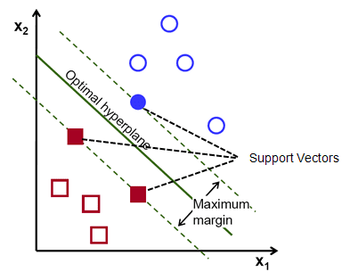
Support Vector Machines
Supervised | Regression | Classification
A hyperplane is a line that splits the input variable space. In SVM, a hyperplane is selected to best separate the points in the input variable space by their class, either class 0 or class 1
RBF Kernel
Functions which takes low dimensional input space and transform it to a higher dimensional space i.e. it converts not separable problem to separable problem, these functions are called kernels.
The distance between the hyperplane and the closest data points is referred to as the margin. The best or optimal hyperplane that can separate the two classes is the line that has the largest margin.

Slide 12
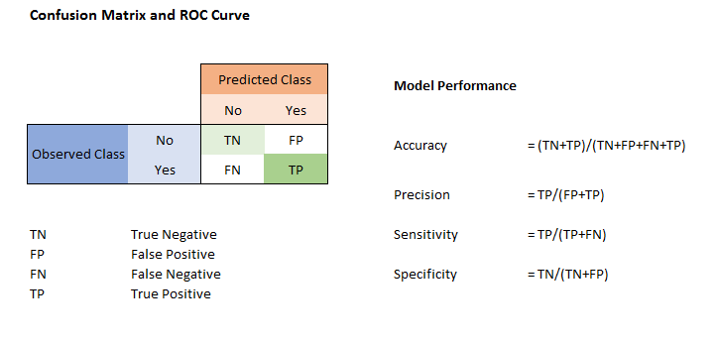
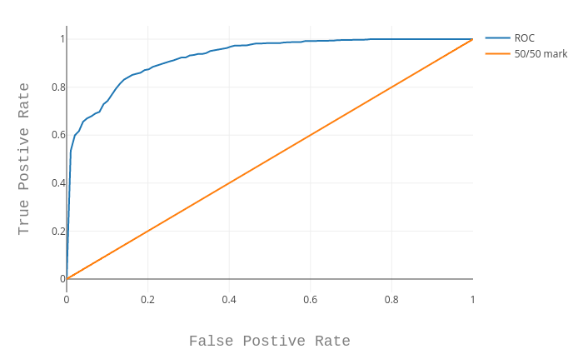
Evaluation of classification models
Confusion Matrix
The number of correct and incorrect predictions are summarized with count values and broken down by each class.
The confusion matrix shows the ways in which your classification model is confused when it makes predictions.
ROC Curve
An ROC curve (receiver operating characteristic curve) is a graph showing the performance of a classification model at all classification thresholds. This curve plots two parameters:
True Positive Rate and False Positive Rate
AUC provides an aggregate measure of performance across all possible classification thresholds.

Slide 13
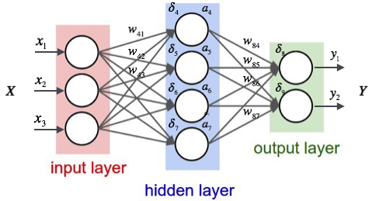
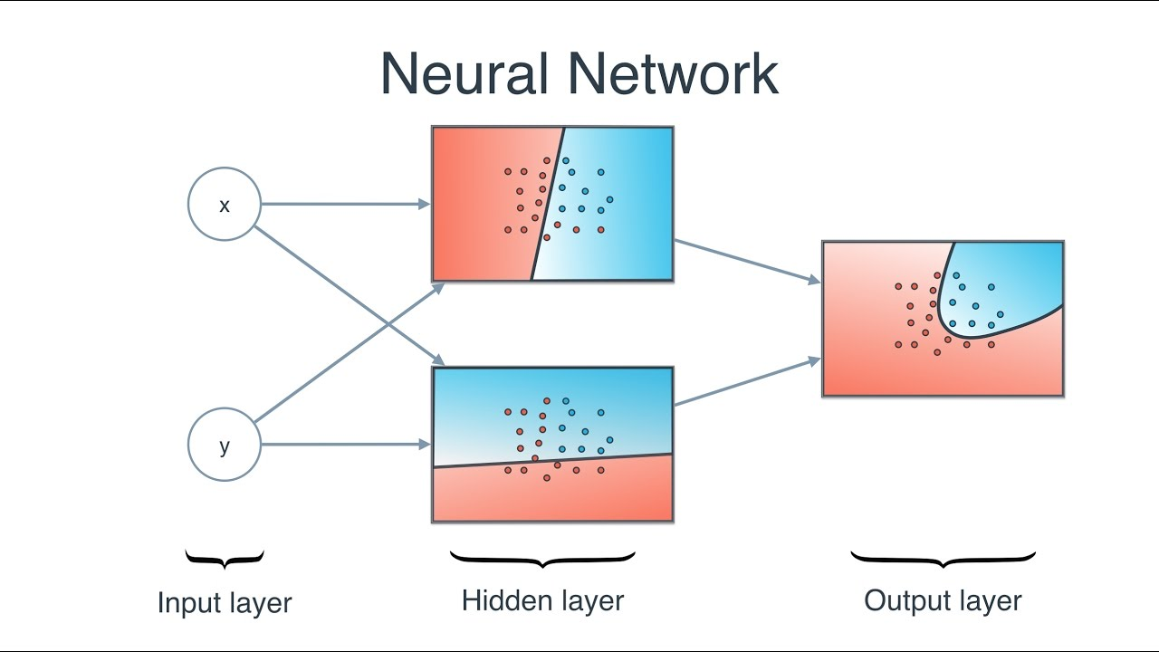
Neural Networks
Naturally, the right values for the weights and biases determines the strength of the predictions. The process of fine-tuning the weights and biases from the input data is known as training the Neural Network.
Calculating the predicted output ŷ, known as feedforward
Updating the weights and biases, known as backpropagation
Objective in training is to find the best set of weights and biases that minimizes the loss function using the optimizer like gradient descent..
Activation functions are non-linear complex functional mappings between the inputs and response variable. They introduce non-linear properties to our Network.

Slide 14
Appendix

Slide 15
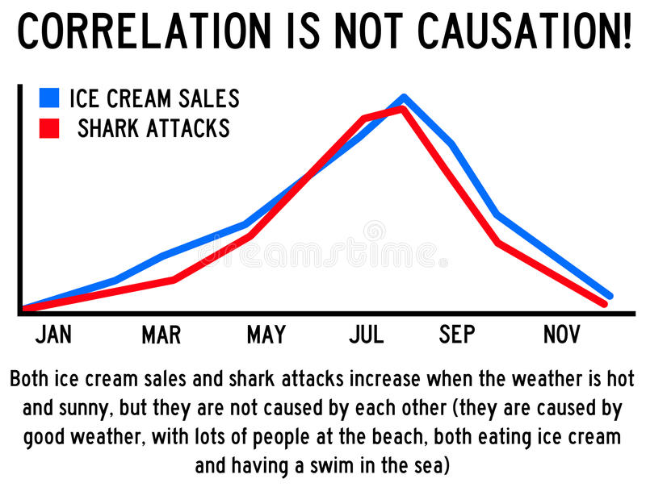
Basic Statistics

Slide 16
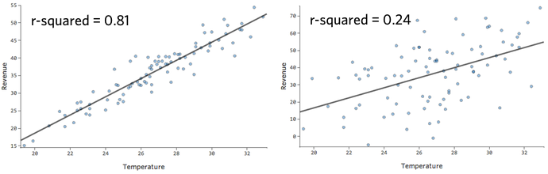
Linear Regression
Supervised | Regression | Classification
 |  | x
Generating the equation : y = B0 + B1 * x
Uses ordinary least squares method or gradient descent optimization to find weights.

Slide 17
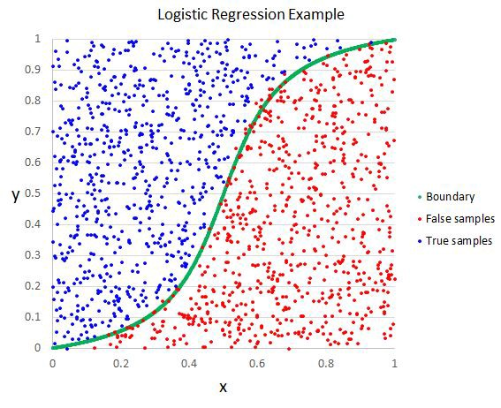
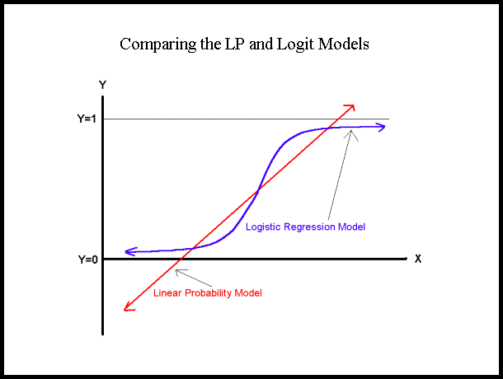

Logistic Regression
Supervised | Regression | Classification
 | x
Generating the equation :
Uses Maximum Likelihood Estimation to find weights.

